Slide 1

European Signal Processing Conference 2011
View Interpolation With Structured Depth From Multiview Video
Pravin Kumar Rana and Markus Flierl
ACCESS Linnaeus Center
School of Electrical Engineering
KTH Royal Institute of Technology
Stockholm, Sweden

Slide 2
Introduction
Estimated depth maps usually demonstrate only a weak inter-view consistency
Improved the consistency by using inter-view connection information resulting from the depth consistency testing
Inconsistent depth maps affect negatively the quality of view rendering
Inter-view connection information resulting from depth consistency testing improve the visual quality of the rendered views
Visual discomfort due varying illumination among views
Minimizes the impact of changing illumination on the rendered views
Slide 1

Slide 3
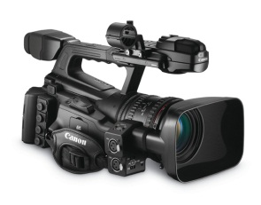
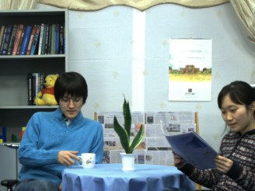
Imaging
Classical Imaging
Slide 2

Slide 4
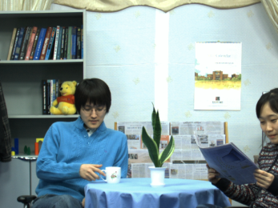
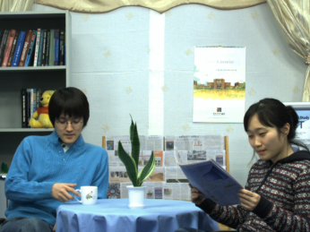
Imaging
Multiview Imaging
Slide 2

Slide 5

Application
User
Free Viewpoint TV
Slide 3

Slide 6
Application
User
Free Viewpoint TV
Slide 3

Slide 7
Application
User
Free Viewpoint TV
Slide 3

Slide 8
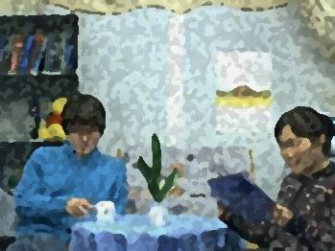
Application
User
Free Viewpoint TV
Slide 3

Slide 9
Virtual View
Slide 4

Slide 10
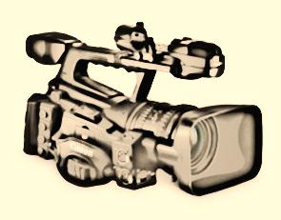
Virtual View
Virtual Camera
Virtual View
Slide 4

Slide 11
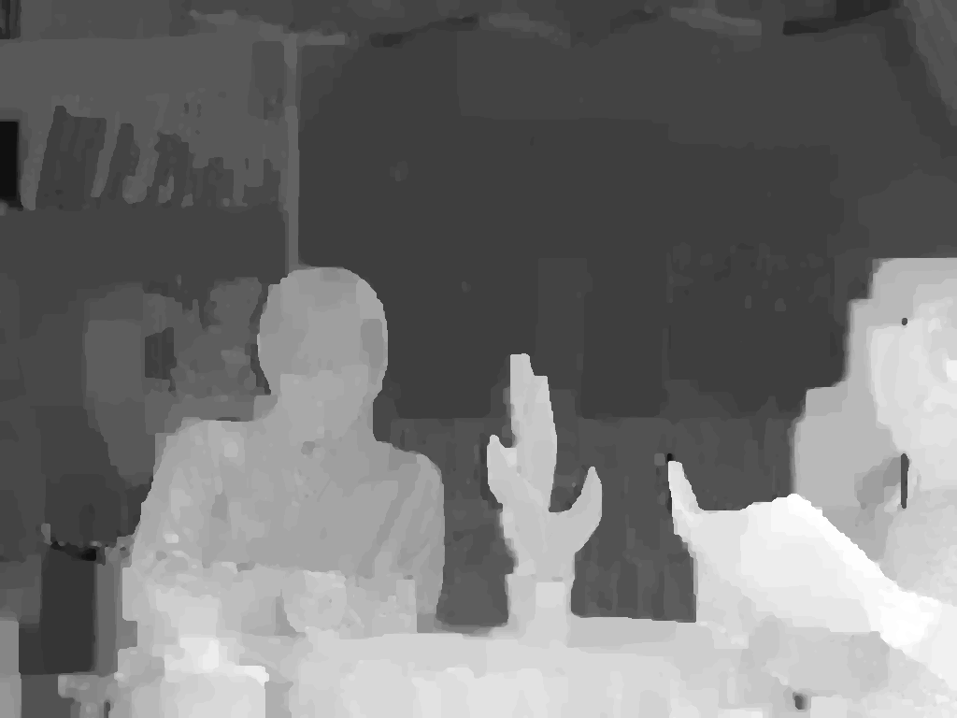
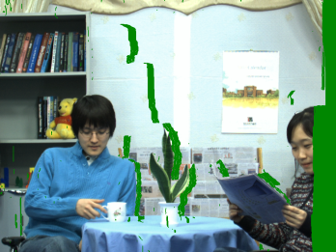

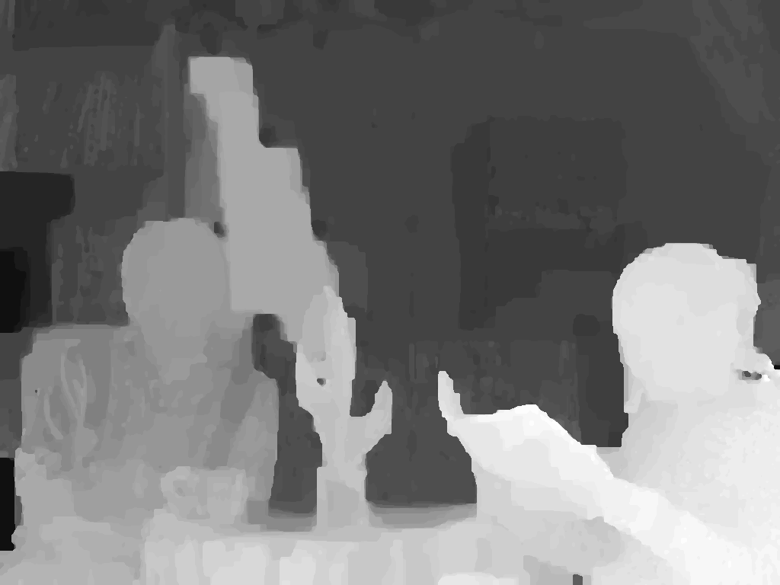
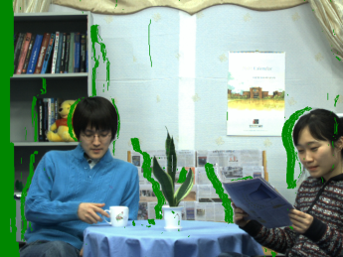
Virtual View Rendering
Estimated Depth
Warped Texture
3D Warping
Hole
Reference Texture
Hole Filling & Inpainting
Estimated Depth
Virtual Texture
3D Warping
Warped Texture
Reference Texture
Example: MPEG View Synthesis Reference Software 3.5 (VSRS 3.5)
Slide 5

Slide 12



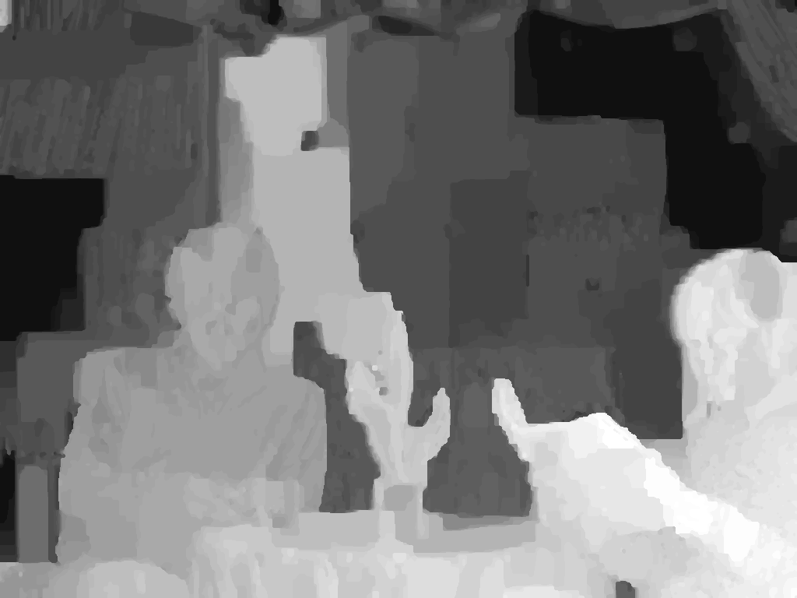
Depth Estimation
Reference Textures
Common Practice
Depth Estimation
Example: MPEG Depth Estimation Reference Software DERS
Estimated Depth Map
Slide 6

Slide 13
Inter-view Depth Inconsistency
Newspaper
Slide 7

Slide 14
Inter-view Depth Inconsistency
Newspaper
Slide 7

Slide 15
Inter-view Depth Inconsistency
Newspaper
Slide 7

Slide 16
Inter-view Depth Inconsistency
Newspaper
Slide 7

Slide 17
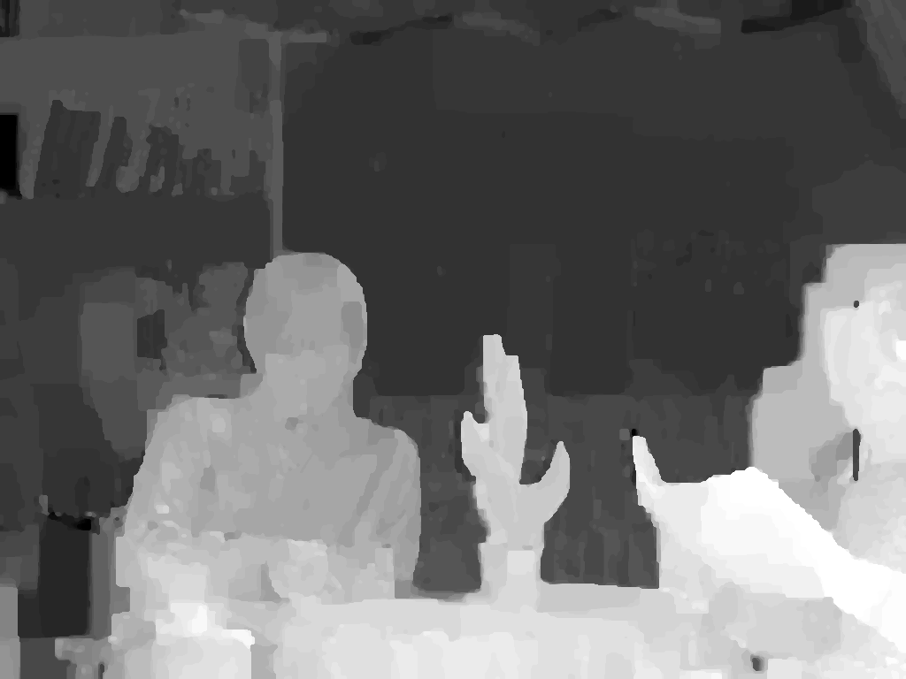

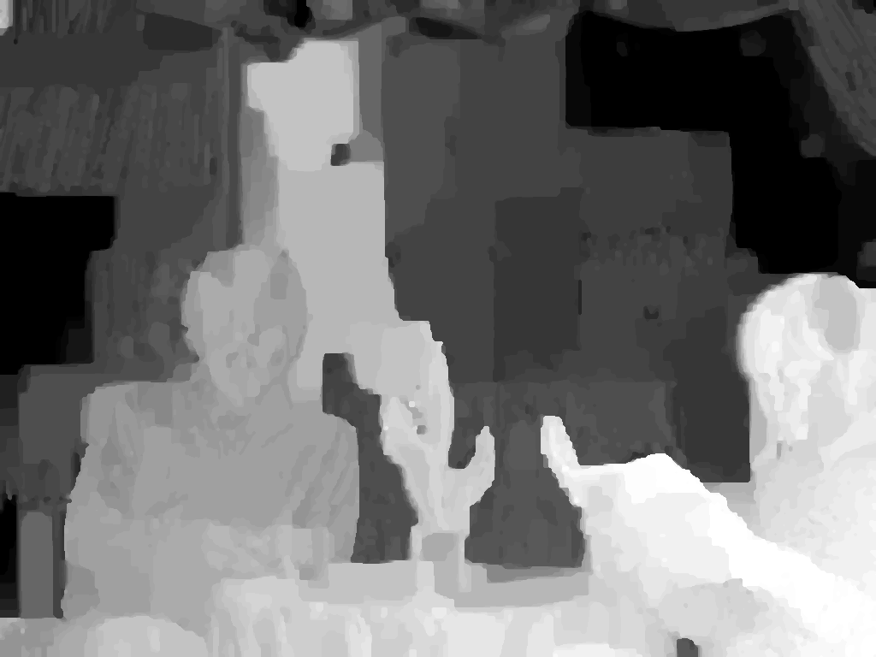
Multiple Depth Warping
Slide 8

Slide 18
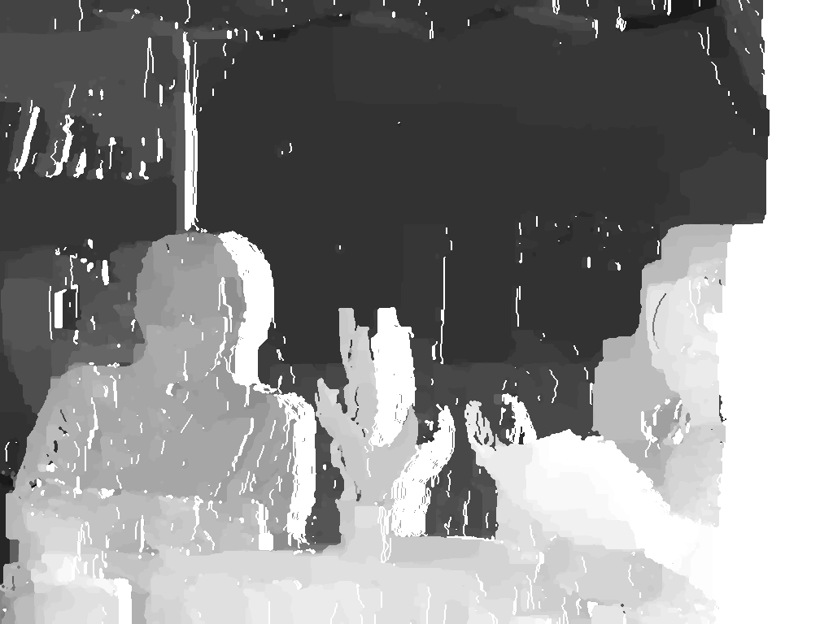
Multiple Depth Warping
3D Warping to
a principal viewpoint p
Hole
Slide 8

Slide 19
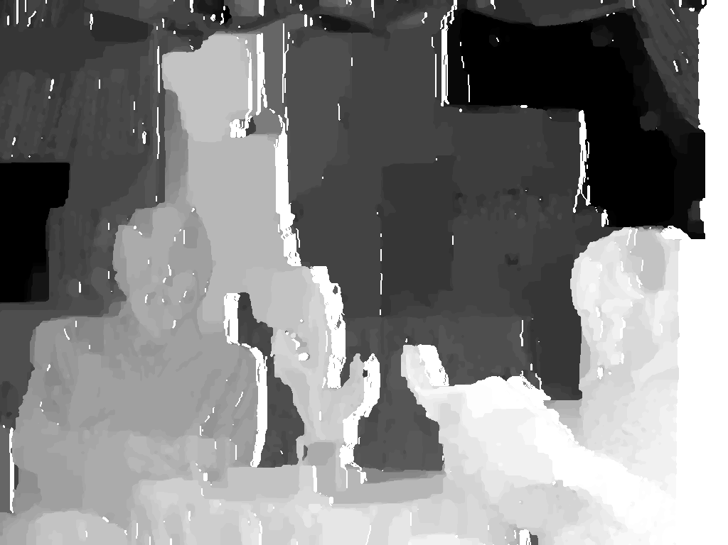
Multiple Depth Warping
3D Warping to
a principal viewpoint p
Hole
Slide 8

Slide 20
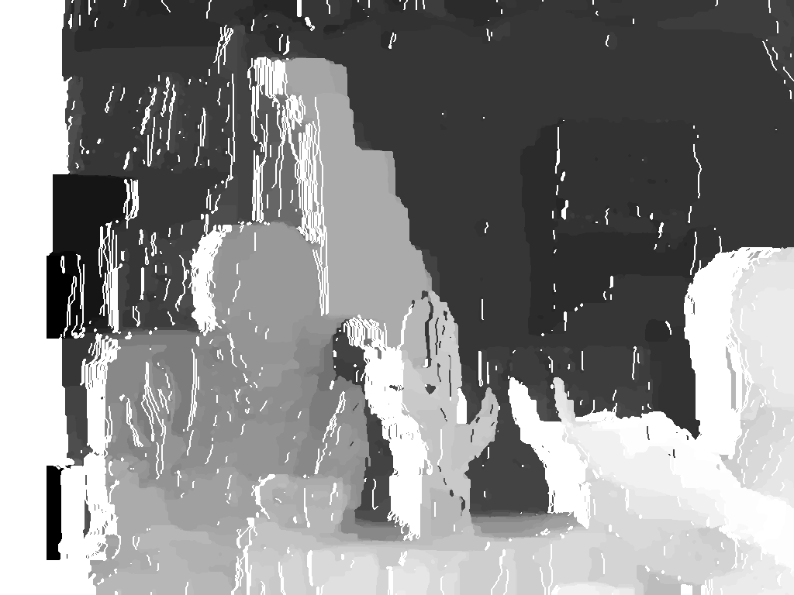
Multiple Depth Warping
3D Warping to
a principal viewpoint p
Hole
Multiple Warped Depth Maps at a principal viewpoint p
Slide 8

Slide 21
Connection Evidence
Absolute Difference
Matrix (ADM)
per pixel per frame
=
,
,
,
Pixel 1
Pixel 2
Pixel M
where, is the absolute difference of depth values between warped depth map and
warped depth map at a principal pixel
M is the resolution of the depth map
Slide 9

Slide 22
Connection Evidence
Absolute Difference
Matrix (ADM)
per pixel per frame
=
Pixel 1
Pixel 2
Pixel M
where, and is a measure of depth consistency between the corresponding depth pairs at a principal pixel.
Slide 8

Slide 23
Connection Evidence
Absolute Difference
Matrix (ADM)
per pixel
=
where, and is a measure of depth consistency between the corresponding depth pairs at a principal pixel.
Slide 8

Slide 24
Connection Evidence
Inter-view Connection Evidence
Absolute Difference
Matrix (ADM)
per pixel
=
where, and is a measure of depth consistency between the corresponding depth pairs at a principal pixel.
Slide 8

Slide 25
Connection Evidence Testing
Connection evidence is a measure of inter-view consistency.
Connection threshold
Relates to the quality of the connectivity
Trade-off between noise and outlier separation,
In rendering experiment:
Testing Rules:
:
Accept the connection evidence
The corresponding depth values have a consistent depth representation
: Reject the connection evidence.
Slide 9
Notes:
2.2 Connection Hypothesis Testing
Connection evidence is a measure of inter-view
consistency.
Connection Threshold (Tf ):
•

Slide 26
Inter-View Connection Information
Example for inter-view connection information with three reference views, n=3.
Slide 10

Slide 27
Inter-View Connection Information
Example for inter-view connection information with three reference views, n=3.
Slide 10

Slide 28
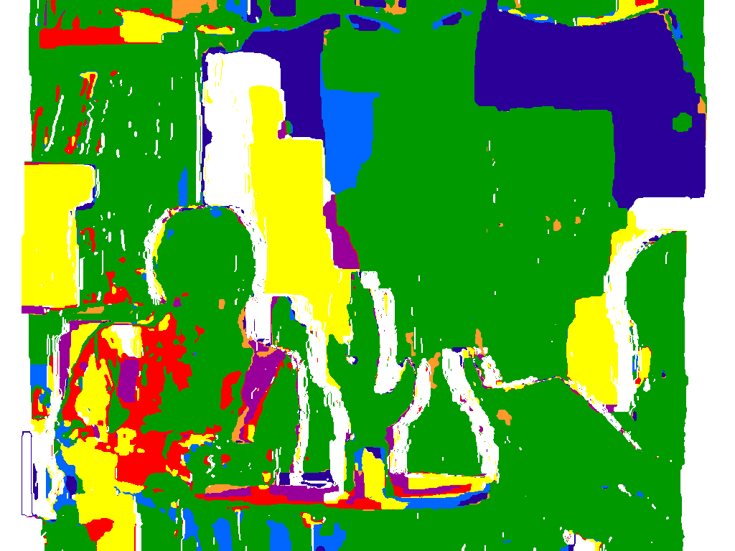
Inter-View Connection Information
Possible cases of inter-view connectivity for n = 3:
Use of Connection Information:
To obtain consistent depth values
To combine texture pixels reliably
Slide 11

Slide 29

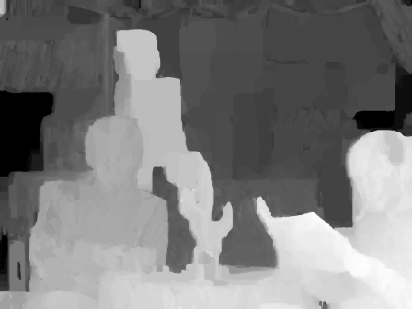
Principal Depth Map
Inter-view
Connection Information
Inter-view
connection Information
Depth Consistency Testing
Consistent Depth Values
Estimated Depth Maps
Principal Depth Map
Slide 12

Slide 30
Structured Depth Maps
To remove redundancy from depth maps
To improve the quality of depth maps
To have efficient depth representation
Slide 13
Notes:
The cardinality |d| of the set d depends
on the number of reference views used for depth consistency
testing to obtain the principal depth map dp. Let dr , r ∈ {1, . . . ,n},
represent an arbitrary reference depth map from viewpoint r which
is used in the depth consistency testing to obtain a principal depth
map at viewpoint p. The cardinality of the set d is defined by
|d| =
(n−1) if p = r, ∀ r,
n if p = r, ∀ r, (4)
where n is the number of reference views used in the depth consistency
testing

Slide 31

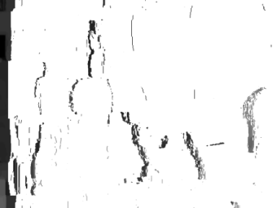
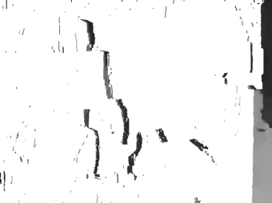
Structured Depth Maps
Structured
Depth Map
=
,
,
,
,
Principal Depth Map
A set of auxiliary depth information at given
auxiliary points
Cardinality of the set of auxiliary depth information:
where, N= Number of reference views used in the depth consistency testing.
Slide 13
Notes:
The cardinality |d| of the set d depends
on the number of reference views used for depth consistency
testing to obtain the principal depth map dp. Let dr , r ∈ {1, . . . ,n},
represent an arbitrary reference depth map from viewpoint r which
is used in the depth consistency testing to obtain a principal depth
map at viewpoint p. The cardinality of the set d is defined by
|d| =
(n−1) if p = r, ∀ r,
n if p = r, ∀ r, (4)
where n is the number of reference views used in the depth consistency
testing

Slide 32
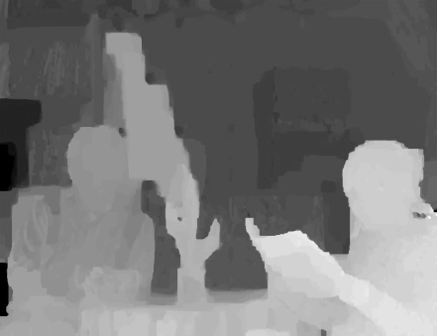



Extraction of Auxiliary Depth
Extraction
Reference Depth Map
Auxiliary Depth
Warping
Principal Depth Map
Occlusion Mask
Slide 14

Slide 33
Rendering Using Structured Depth Images
Multiview Video
Multiview Video
Inter-View Connection Information
Storage/
Transmission
Medium
Structured-Depth-Image-Based
Rendering
Structured Depth Estimation
Inter-View Connection Information
3D Scene Representation
Display
Structured Depth Maps
Structured Depth Maps
Slide 15

Slide 34
Virtual View Rendering
User
Free Viewpoint TV
Slide 2

Slide 35
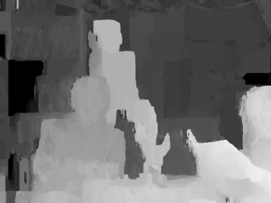
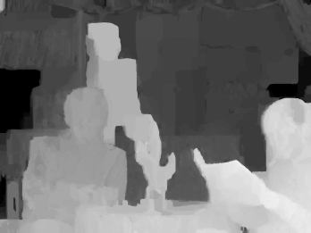
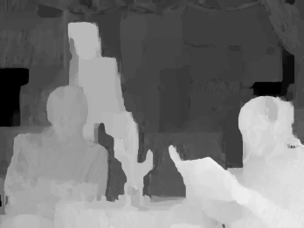
Virtual View Rendering
Enhanced depth maps
resulting from SDI
Slide 16

Slide 36
Virtual View Rendering
Multiview Texture
Slide 16

Slide 37
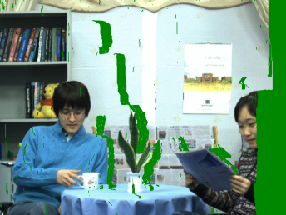
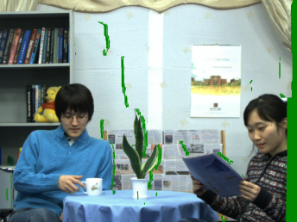
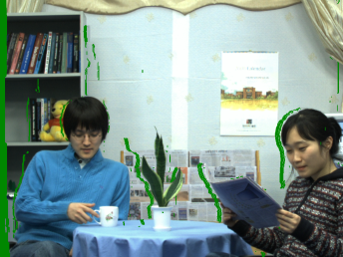
Virtual View Rendering
Warped views
at virtual viewpoint n
Warping
Warping
Warping
Slide 16

Slide 38
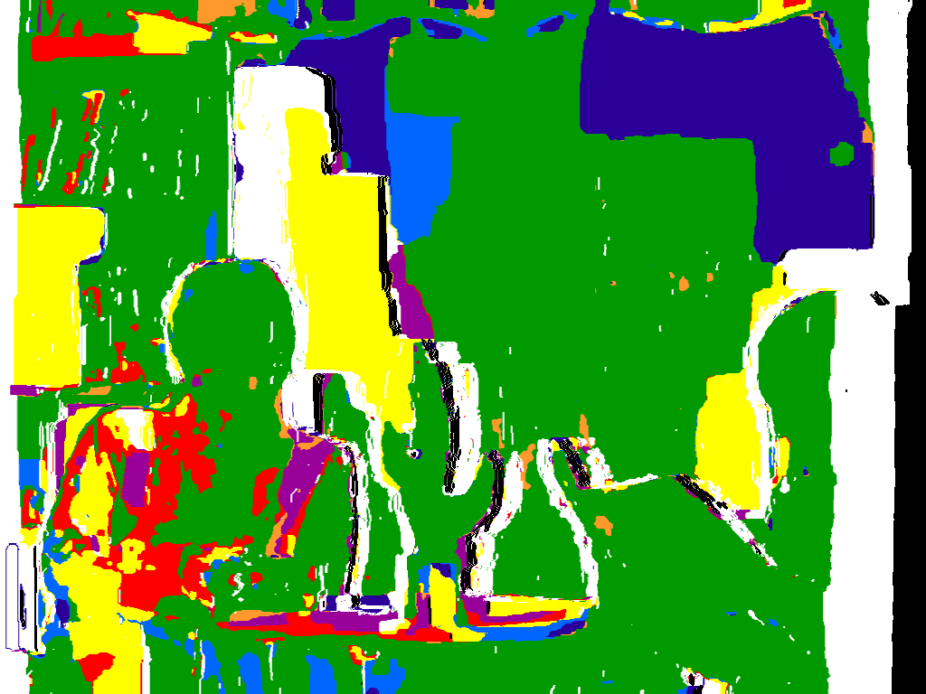
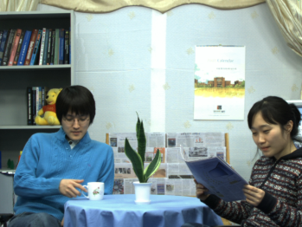
Virtual View Rendering
Warped views
at virtual viewpoint n
Warping
Warping
Connection-Adaptive
Pixel Intensity Estimation
Masked Inter-view
Connection Information
Warping
Slide 16

Slide 39
Experimental Results
[Left Bar ] : Proposed Method
[Right Bar] : VSRS 3.5
Mobile
Dog
Lovebird1
Newspaper
38 40 38 40 05 07 02 04 04 06
Slide 17

Slide 40
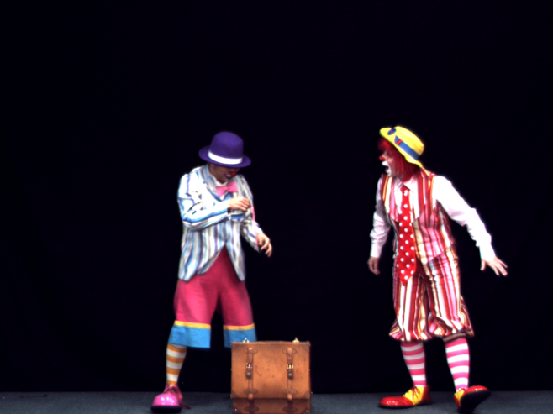
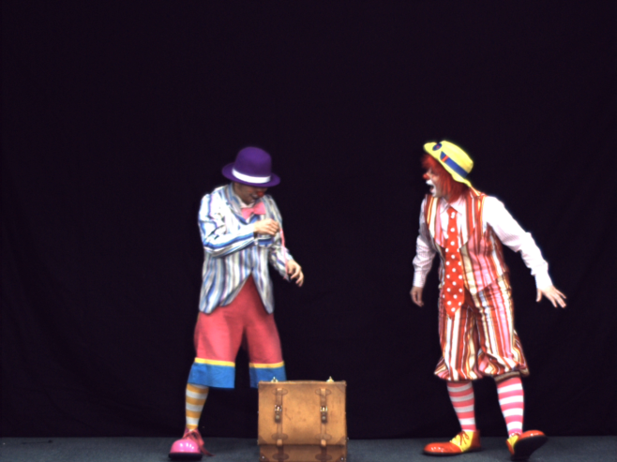

Experimental Results
Original
Virtual View by VSRS 3.5
Virtual View by Proposed Method
Error Image
Error Image
VSRS 3.5
Pantomime
Proposed Method
Slide 18

Slide 41
Experimental Results
Original
Virtual View by VSRS 3.5
Virtual View by Proposed Method
VSRS 3.5
Proposed Method
Slide 18

Slide 42
Conclusions
It exploits the inter-view connectivity information among multiview video and takes advantage of a consistent principal depth map
It addresses the problems of inter-view depth inconsistencies and varying illumination conditions
Structured depth maps permit an appealing 3D scene representation on the encoder side by avoiding depth consistency testing for each interpolated pixel on the decoder side
Consistent and connection information improves the quality of rendered views
Slide 19

Slide 43
Thank You

